Slide 1
Group
曹凱雲 Chou Racheal
umtec.rachelc@um.edu.mo
現為修復及考古歷史研究員，澳大建築遺產修復團隊
學習經歷：
復旦大學，歷史學碩士，考古學
吉林大學，歷史學學士，博物館學
研究方向：歷史考古，博物館史
學術成果：
期刊文章
- 郭嵩燾眼中的西方博物館形象（2015）
- 基於中國知網《中國博物館》2000至2013年文獻計量學分析（2015）
論文集
- 晚清時期《知新報》中的博物館形象與概念初探（2024）
- 博物館考古教育活動的思考與實踐──以台灣地區博物館為例（2021）
講座
如何對待遺產價值──從上海外灘說起（2017）
Academic Qualification
Fudan University, Master of History, Archaeology
Jilin University, B.A. History, Museum Studies
Research Interests:
Historical Archaeology, Museum History.
She has published two journal papers, two conference papers, and organized one lecture.

Slide 2
PAGE 3
Group
吳靖彤 Ung Cheng Tong
澳門出生，獲臺北藝術大學劇場設計學士學位，主修燈光設計；回澳後獲取建築學碩士學位，主修建築遺產保護。
曾於台灣及澳門參與劇場規劃、場燈光設計和藝術展覽等。
於碩士在學期間參與多項活動：2021 拯救山西傳統村落工作營、2022 歷史性城鎮景觀保護和規劃青年培圳工作坊、2023 藏羌碉樓及傳統村落保護國際工作營。
2017年，其設計的燈光作品入選四年一屆”世界劇場設計展”；
2022年加入團隊參與威尼斯建築雙年展澳門區參展方案競賽，其提案獲銅獎。
Born in Macao, she obtained a bachelor's degree in Theater Design with a concentration in lighting design from the Taipei University of the Arts, as well as a master's degree in Architecture with a focus on architectural heritage conservation.
She has participated in numerous projects, including theater facility design and consulting, stage lighting design, and art exhibitions in Taiwan and Macao. 2021 Saving Traditional Villages in Shanxi, 2022 Youth Training Workshop on Landscape Conservation and Planning for Historic Townships, 2023 International Workshop on Conservation of -Qiang Watchtowers and Traditional Villages.
In 2017, the lighting designs she created were selected to the once-in-four-years World Stage Design.
In 2022, she joined a team to participate in the “International Architecture Exhibition of La Biennale di Venezia – Collateral Event from Macao, China” Open Call for Exhibition Proposals, winning the Bronze Prize.

Slide 3
PAGE 3
Group
李曉月 Li Xaoyue
umtec.lixy@um.edu.mo
現為澳大建築遺產修復團隊，建築遺產修復實驗室技術員，
學習經歷：
上海交通大學大學，工學博士，土木工程
長安大學，工學學士，土木工程
工作經歷：
澳門大學，智慧城市物聯網國家重點實驗室，研究助理
珠海澳大科技研究院，智慧城市研發中心，博士後研究員
研究方向：
多場耦合作用下土體本構特性研究，地基、邊坡處理，結構受力穩定性分析，智能監測與預警等。
學術成果：
發表SCI論文9篇，EI論文8篇，學術會議論文3篇。
獲發明專利授權4項，實用新型專利授權1項。
作為骨幹成員參與科技部重點研發計劃1項，國家自然科學基金重點項目1項，主持博士後面上項目1項。
Xiaoyue Li got her PhD in Civil Engineering, at Shanghai Jiao Tong University, and is now engaged in architectural heritage restoration.
Her main research interests include the impact of multi-field coupling effects on heritage buildings, structural safety analysis and component rehabilitation of heritage buildings, health monitoring and early warning, numerical simulation and indoor testing. She has published more than 20 papers and has been granted several invention patents, and has hosted one project.

Slide 4
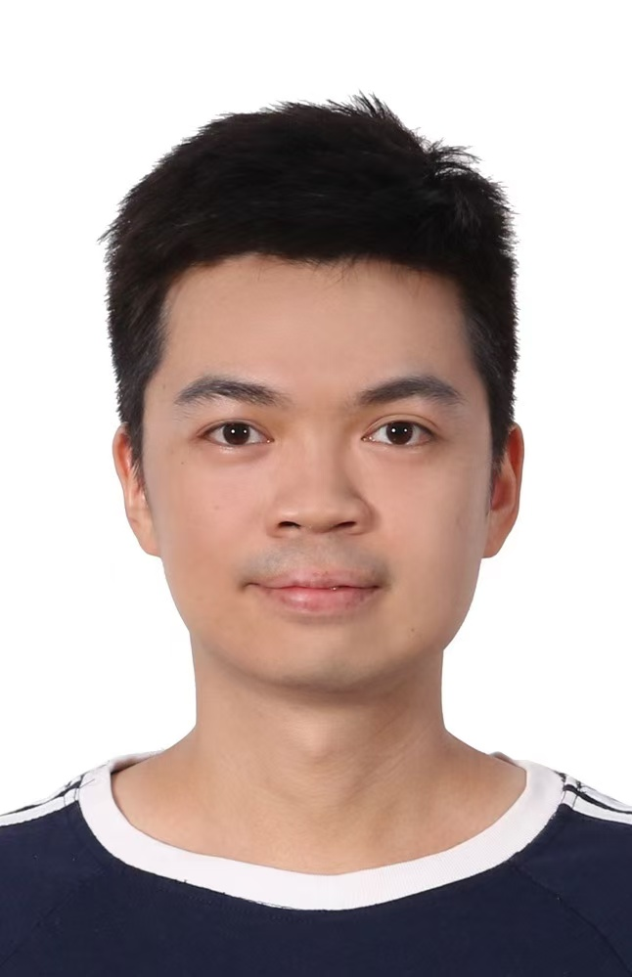
PAGE 3
Group
馮尖 James Jian Feng
學習經歷：
建築學碩士，建築遺產保護方向，澳門科技大學，09/2021-06/2023
材料工學學士，科學與工程專業，南方科技大學，09/2014-06/2018
工作經歷：
初級文物修復師，建築遺產修復團隊，澳門大學，09/2024至今
科研技術助理，海洋考古團隊，南方海洋廣東省實驗室（珠海），11/2020-02/2021
初級研究助理，物理系及文物館，香港中文大學，09/2019-09/2020
科研助理，先進生物材料實驗室及文化遺產中心，南方科技大學，07/2018-07/2019
Academic Qualification
M. Arch. in Heritage Architecture Conservation, Macau University of Science and Technology, Macau, 09/2021-06/2023
B. Eng. in Materials Science and Engineering, Southern University of Science and Technology, Shenzhen, 09/2014-06/2018
Working Experience
Conservator, Built Heritage Conservation Team, Macau University, 09/2024-presentReseacrh Assistant, Archaeology Team, Southern Marine Science and Engineering Guangdong Laboratory (Zhuhai), 11/2020-02/2021Junior Research Assistant, Department of Physics & Art Museum, The Chinese University of Hong Kong, 09/2019-09/2020Research Assistant, Advanced Biomaterials Laboratory & Heritage Center, Southern University of Science and Technology, 07/2018-07/2019

Slide 5
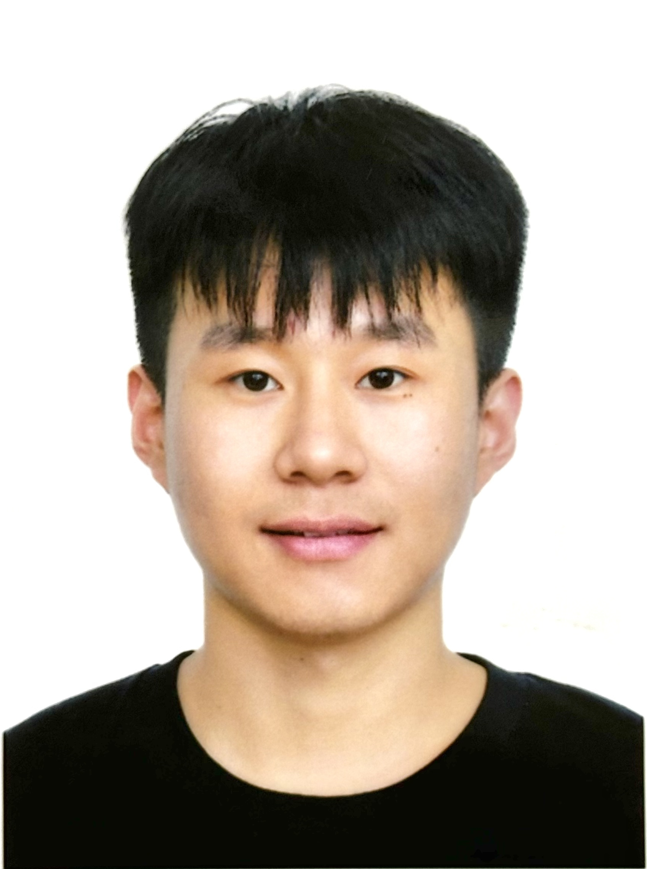
PAGE 3
Group
翟振宏 Zhenhong Zhai
+853 65591824|+86 13153162082|zhaizhenhong86@163.com
學習經歷
建筑学博士，建築可持續設計專業，澳門科技大學，09/2024-至今
建築學碩士，建築遺產保護專業，澳門科技大學，09/2022-06/2024
艺术學學士，环境设计專業，山东建筑大学，09/2016-06/2020
工作經歷
初級文物修復師，建築遺產修復團隊，澳門大學，09/2024-至今
文物建築修復助理，澳門博物館，澳門文化局，07/2023-08/2023
設計管理岗，设计管理部，碧桂園房地產開發有限公司，05/2019-10/2019
設計助理，设计研发部，同圓設計院，05/2018-09/2018
Academic Qualification
Ph.D Student in Sustainable Architectural design, Macau University of Science and Technology, Macau S.A.R., 09/2024-Present
M. Arch. in Heritage Architecture Conservation, Macau University of Science and Technology, Macau S.A.R., 09/2022-06/2024
BFA in Environmental Design, Shandong Jianzhu University, Jinan, 09/2016-06/2020
Working Experience
Conservator, Built Heritage Conservation Team, Macau University, 09/2024-Present
Restoration Assistant, Museu de Macau, Macao Cultural Affairs Bureau, 07/2023-08/2023
Design Management, Design Management Department, Country Garden Real Estate Development Co., Ltd., 05/2019-10/2019
Design Assistant, Design R & D Department, Tong Yuan Design Group Co., Ltd., 05/2018-09/2018

Slide 6
PAGE 3
Group
李金明 Lei Kammeng
澳門出生，從業二十餘年具備豐富的修復及裝修工作經驗和相關工作技能。
修復工程
聖玫瑰堂（板樟堂）截水除鹽工程 – 修復工程指導和材料配比監管工作
草堆街中西藥局內、外牆體修復工程 - 修復工程指導和材料配比監管工作
大三巴牌坊夯土牆體修復工作 – 夯土修復監管和夯製示範
觀音堂壁畫和灰塑修復工程 – 現場文物修復工作
九澳聖母村建築結構和牆體修復工程 – 修復工作監督和材料監管
聖若瑟修院聖物寶庫修復工程 - 修復工程指導和材料配比監管工作
工作技能
- 牆體砌磚、批蕩、油漆
- 搭竹棚、高空工作
- 截水注射、紙漿除鹽
- 換磚、修磚縫
- 壁畫/灰塑修復
- 修復材料調製
Kimmeng has been in the industry for more than 20 years and has rich experience in restoration and decoration work and related work skills. He has been responsible for site work on several heritage restoration projects.
Job Skills: Bricklaying, plastering and painting of walls; Bamboo scaffolding, working at height; Water cut-off injection, de-salting of paper pulp; Replacement of bricks and repair of joints; Mural/plaster restoration; Preparation of restoration materials

